Slide 1


AI TRENDS (BIG DATA ANALYTICS)

Slide 2
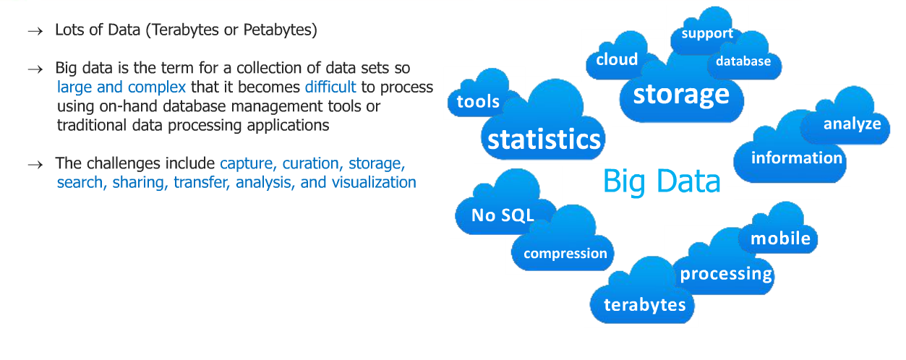
What is big data

Slide 3
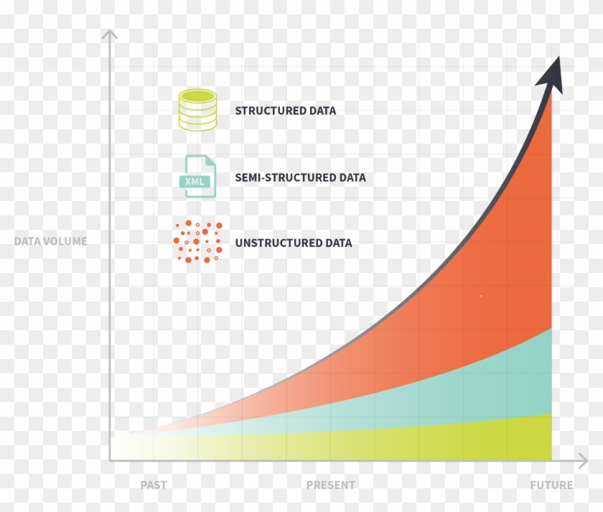
Unstructured data is exploding

Slide 4
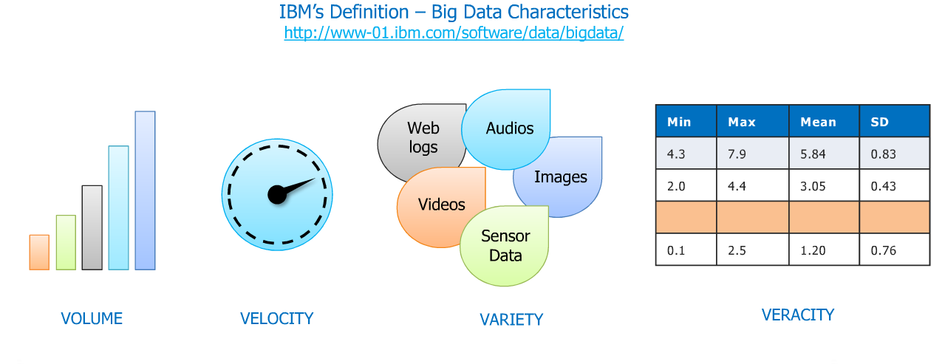
IBM Definition of big data

Slide 5

Types of Big Data
Big Data could be of three types:
Structured
Semi-Structured
Unstructured

Slide 6
Examples of Big Data
Walmart handles more than 1 million customer transactions every hour.
Facebook stores, accesses, and analyzes 30+ Petabytes of user generated data.
230+ millions of tweets are created every day.
More than 5 billion people are calling, texting, tweeting and browsing on mobile phones worldwide.
YouTube users upload 48 hours of new video every minute of the day.
Amazon handles 15 million customer click stream user data per day to recommend products.
294 billion emails are sent every day. Services analyses this data to find the spams.
Modern cars have close to 100 sensors which monitors fuel level, tire pressure etc. , each vehicle generates a lot of sensor data.

Slide 7
Challenges with Big Data
Data Quality
Discovery
Storage
Analytics
Security
Lack of Talent

Slide 8


Big Data Applications
Healthcare
Telecommunication

Slide 9


Big Data Applications
Finance
Retail

Slide 10


Big Data Applications
Education
Automobile

Slide 11

Big Data in Government
Cyber security & Intelligence
Crime Prediction and Prevention
Pharmaceutical Drug Evaluation
Scientific Research
Weather Forecasting
Tax Compliance
Traffic Optimization

Slide 12
Real time scenarios
Facebook: Ad targeting
Air traffic
Electricity grid
Web &e tailing:recommmendations
Twitter
Marketing engine

Slide 14
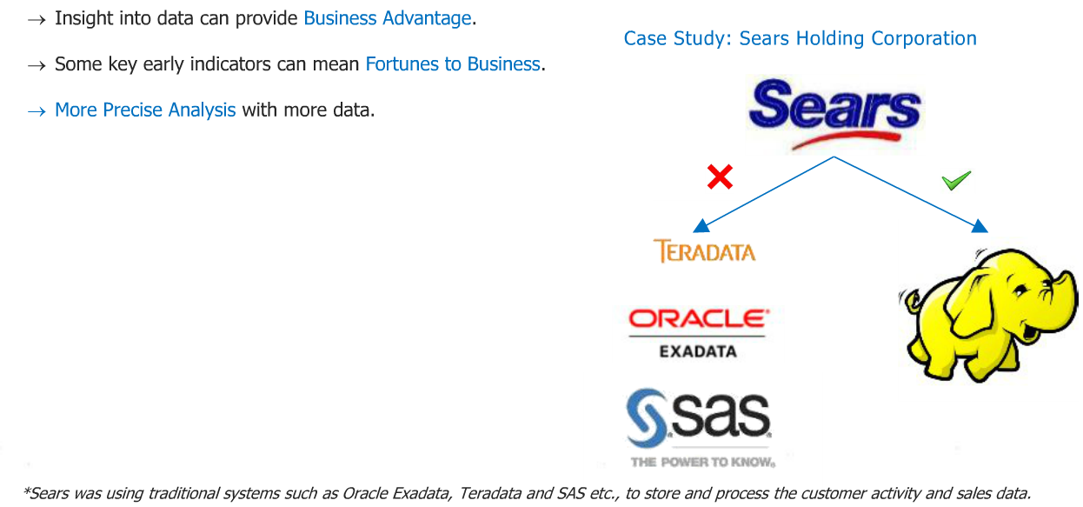
Sears use Hadoop for analysis

Slide 15
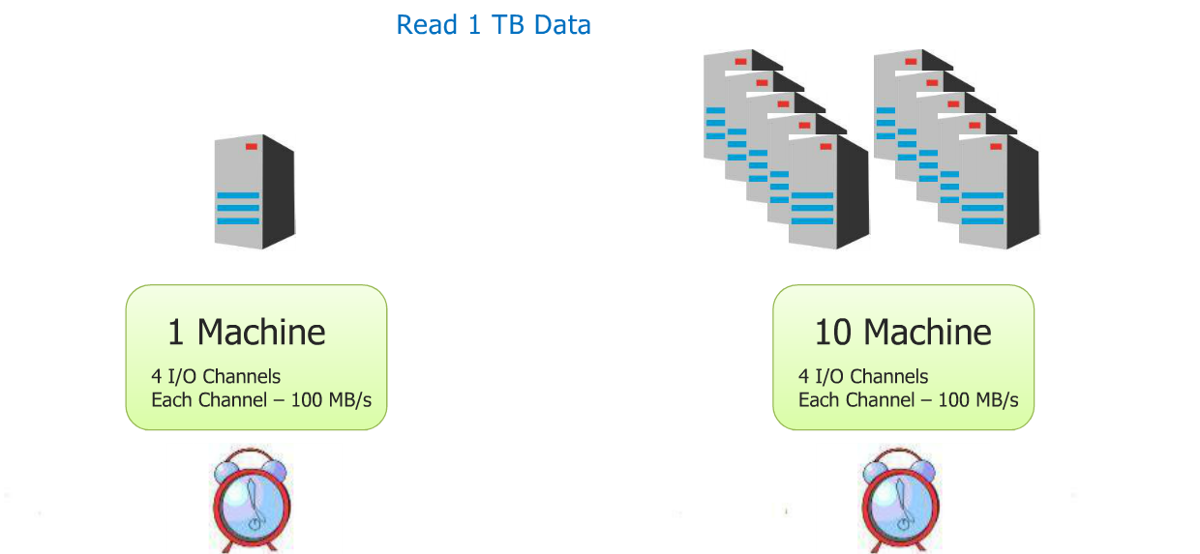
WHY DFS? Distributed file system

Slide 16
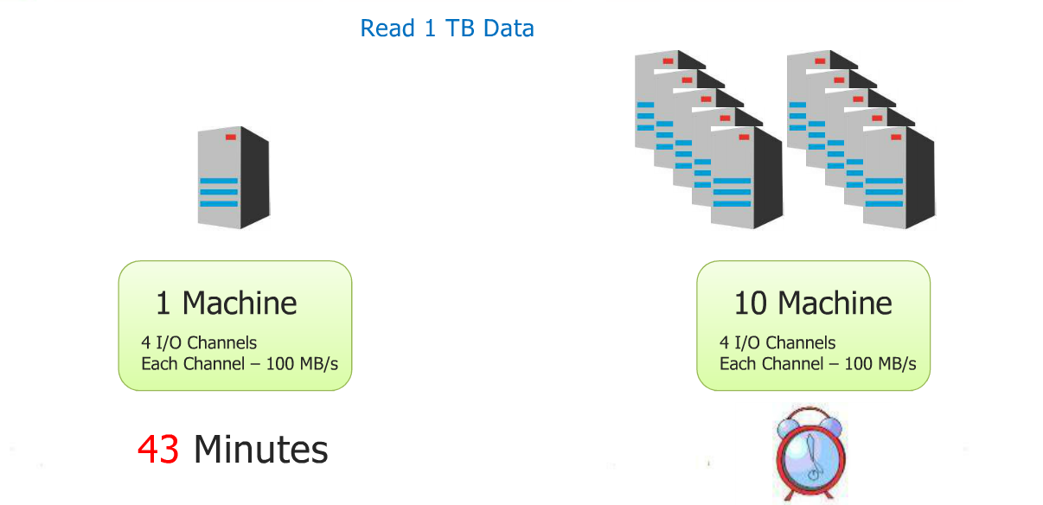

Slide 17
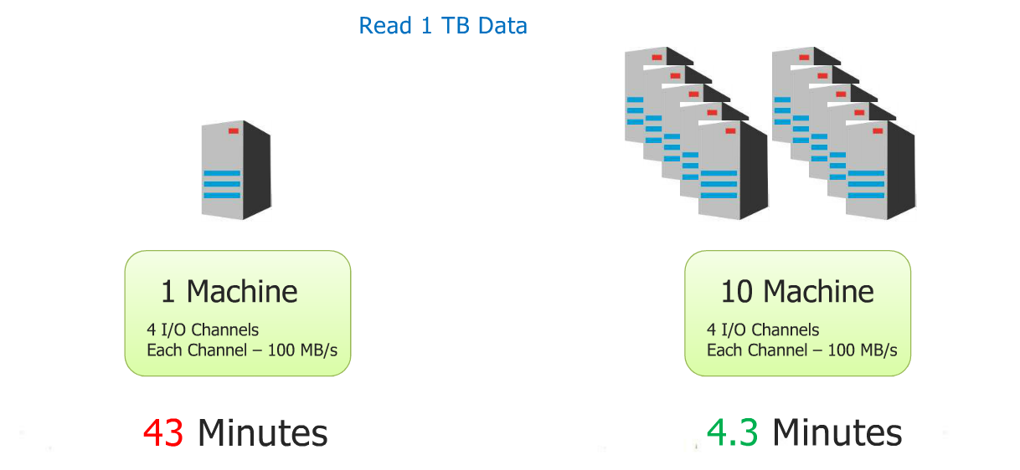

Slide 18
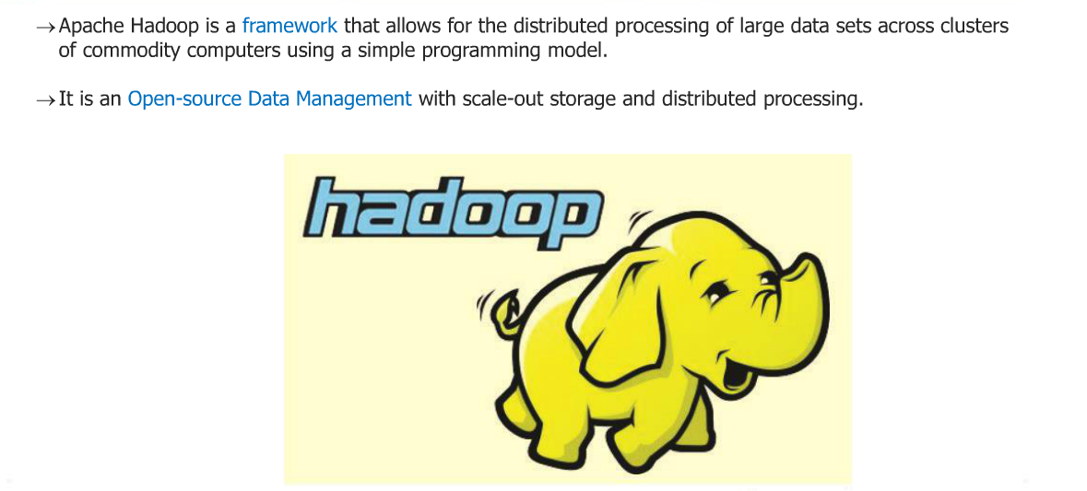
What is Hadoop?

Slide 19
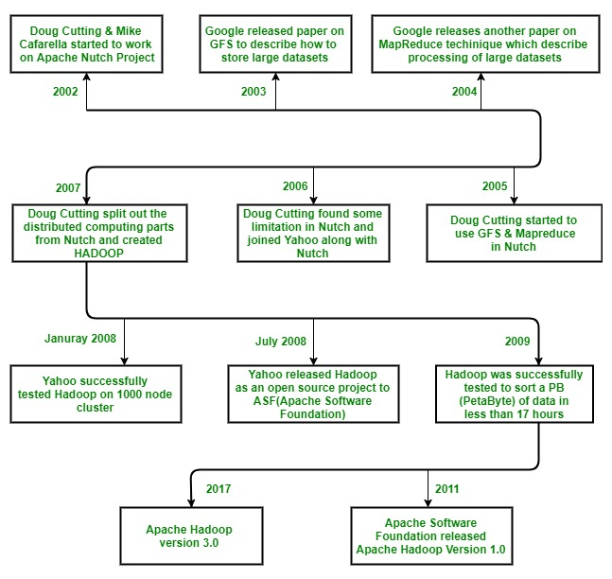
Hadoop History

Slide 20
Hadoop was created by Doug Cutting and Mike Cafarella in 2005. Cutting, who was working at Yahoo! at the time, named it after his son's toy elephant. It was originally developed to support distribution for the Nutch search engine project.

Slide 21
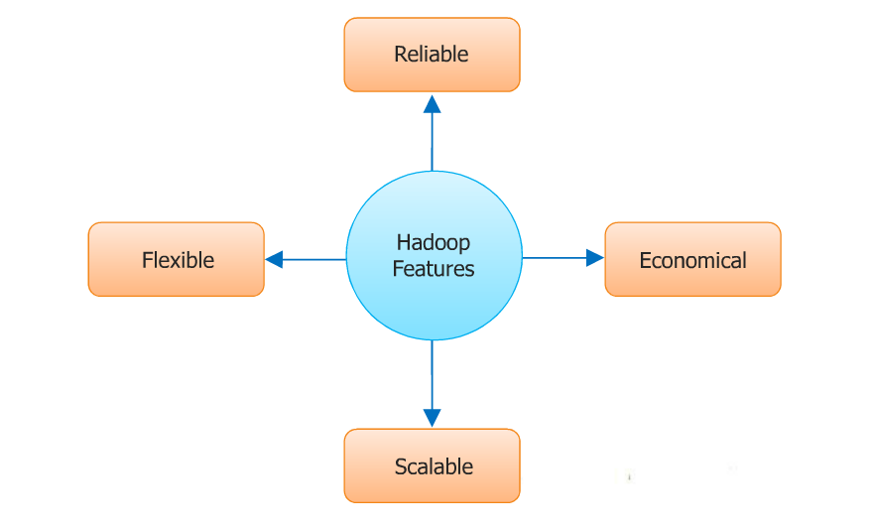
Characterstics

Slide 22
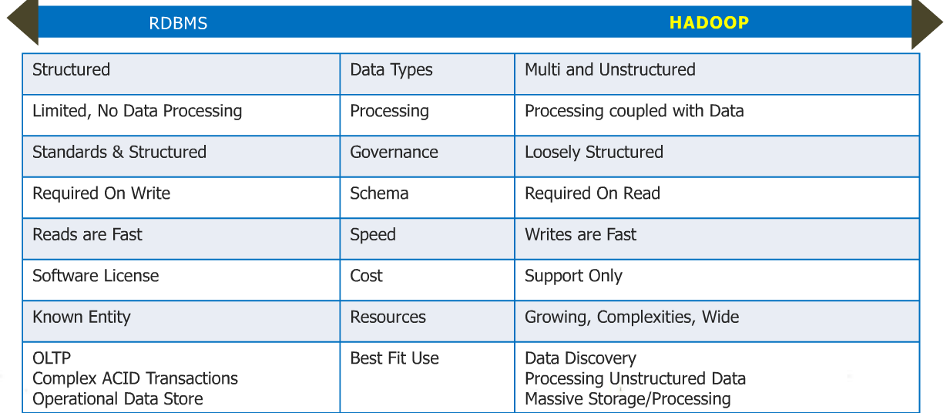
Hadoop-its about scale and structure

Slide 23
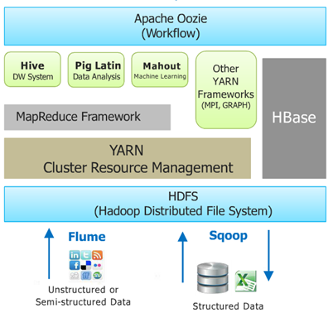
Hadoop ecosystem

Slide 24
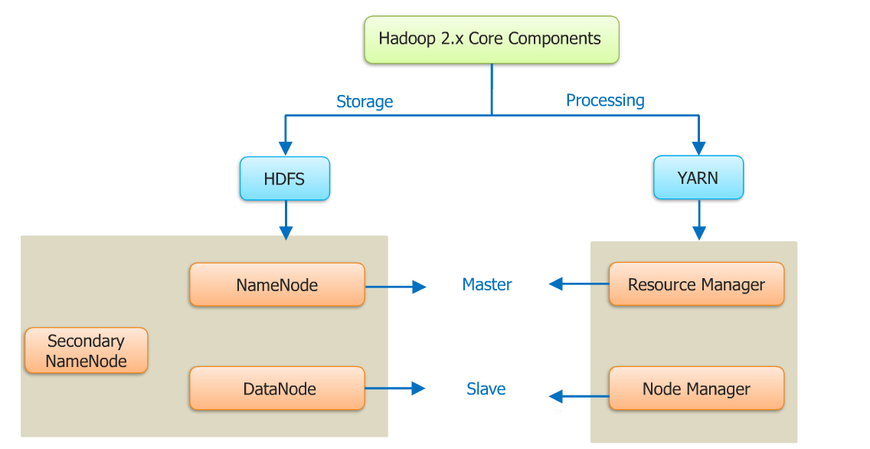
Hadoop 2.X core components

Slide 25
Hadoop 2.X core components

Slide 26
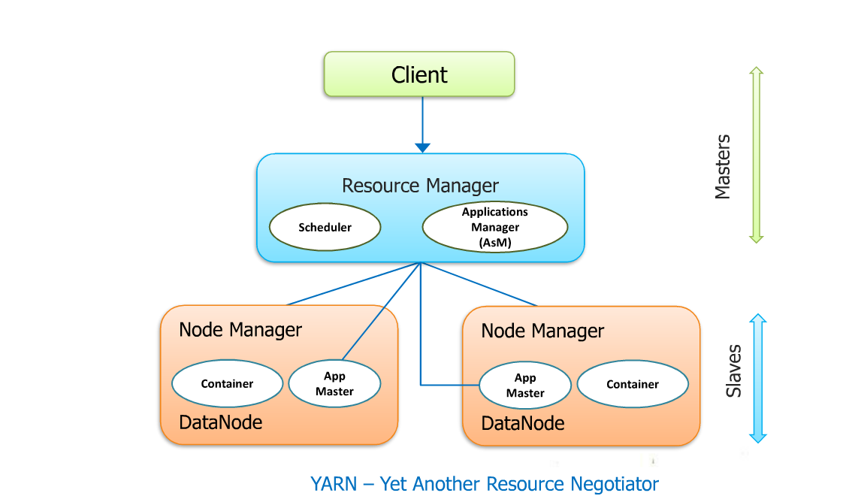

Slide 27
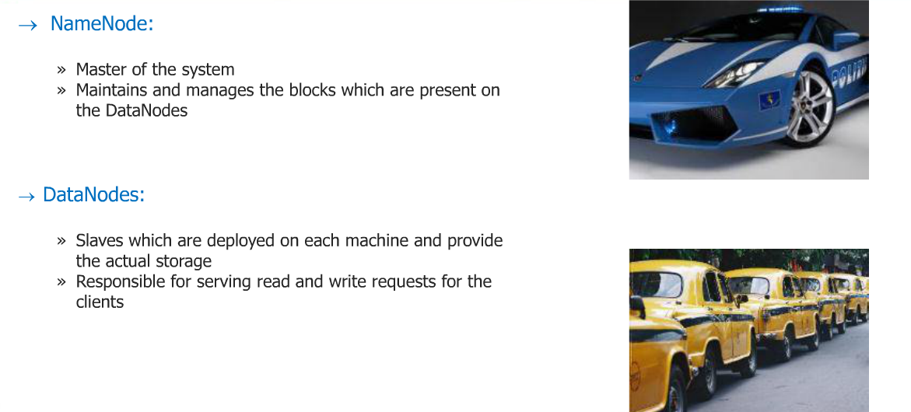
Main components of HDFS

Slide 28
Secondary namenode
Secondary NameNode
Query for EditLogs at regular intervals
NameNode
Updates FsImage image with EditLogs
FsImage
Copy updated FsImage back to NameNode
FsImage

Slide 29
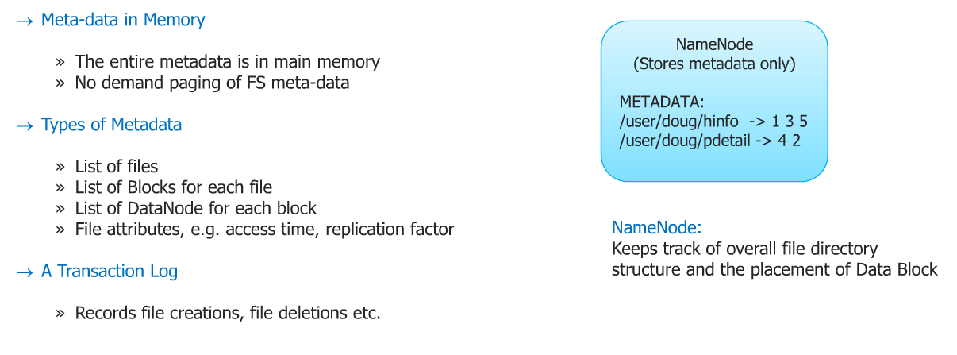
Name Node Metadata

Slide 30
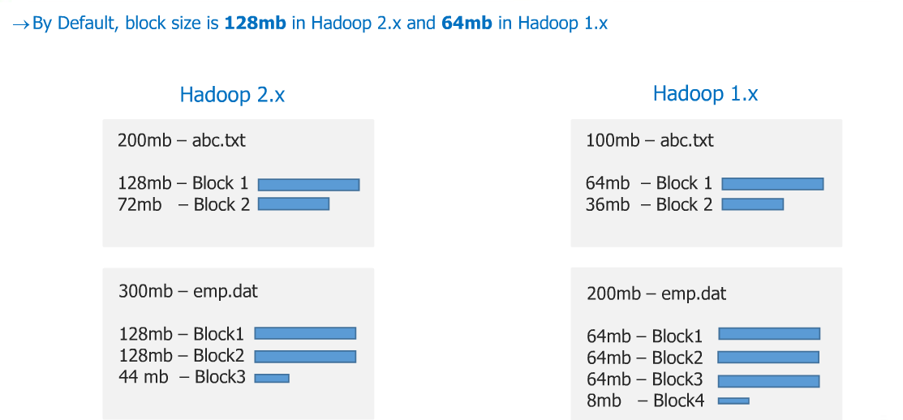
File Blocks

Slide 31
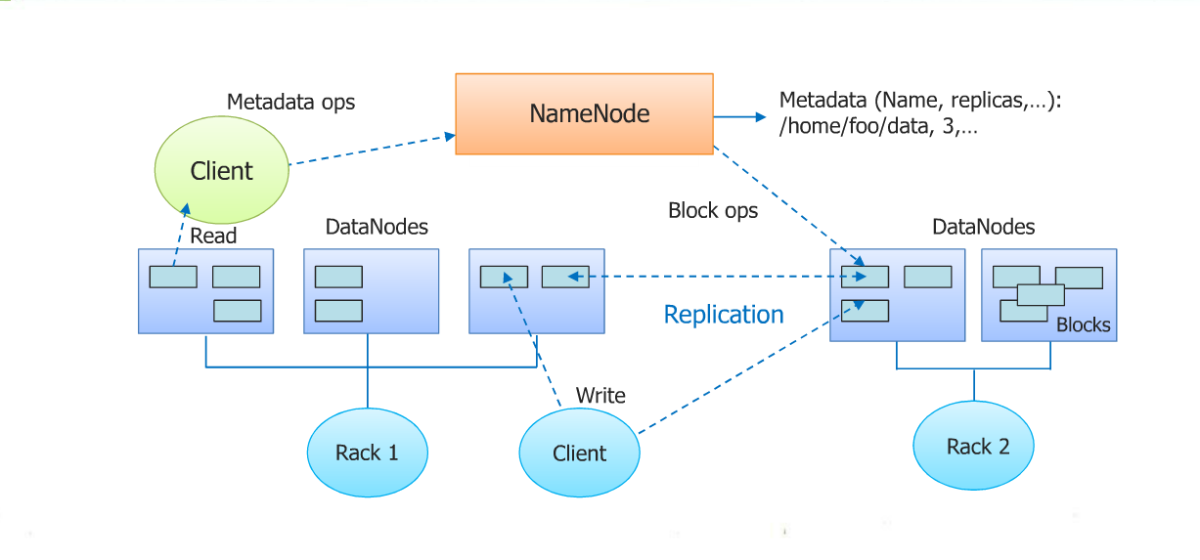
HDFS Architecture

Slide 32
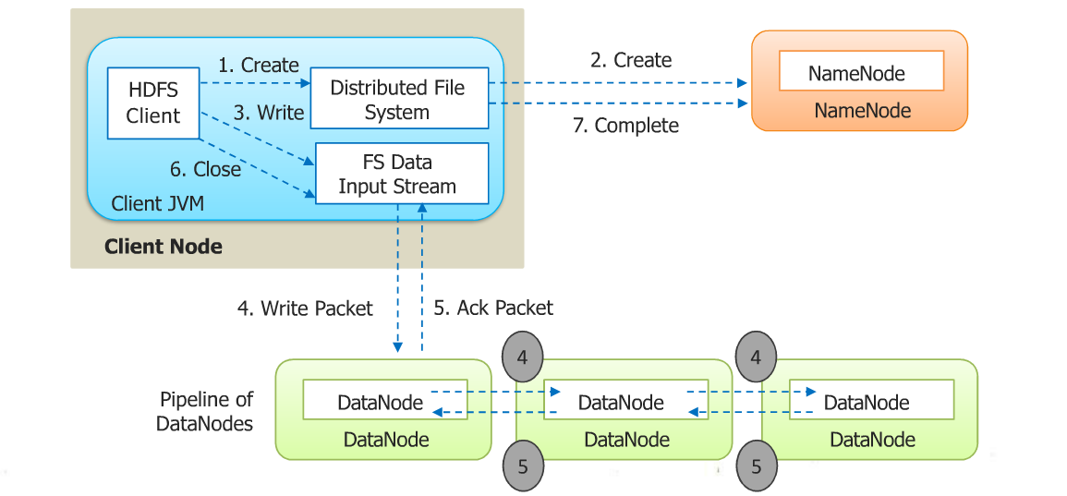
Anatomy of a file write

Slide 33
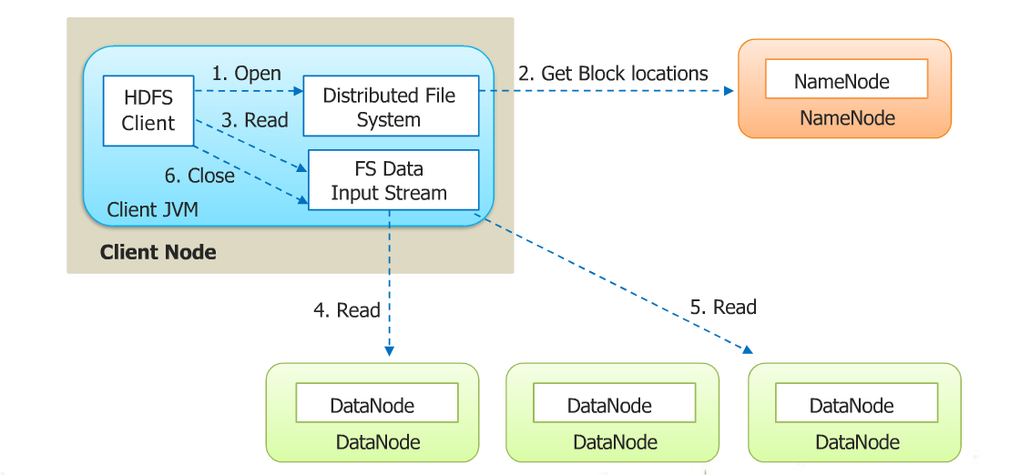
Anatomy of a file read

Slide 34
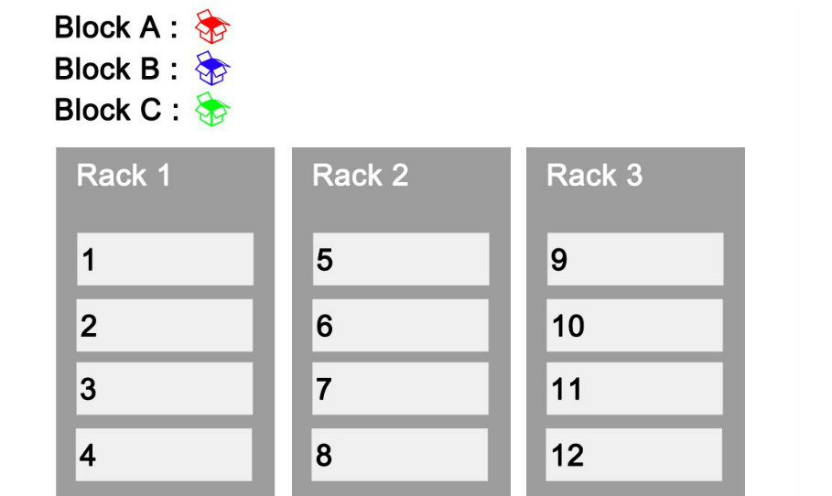
Replication and rack awareness

Slide 35
How namenode should select datanodes?
Two factors:
1. Data nodes should be as close as possible.
2. Data node should be selected such that if there occurs a fault minimum impact should be there.
If we have huge file divided into blocks, the idea is that :Ist copy of blocks should be at one rack and rest two copies at different rack.

Slide 36
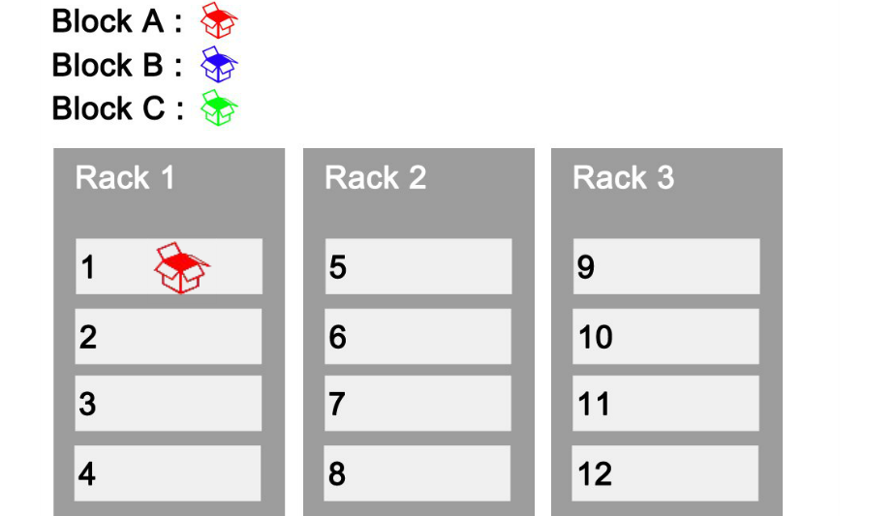
Block A is kept at rack 1

Slide 37
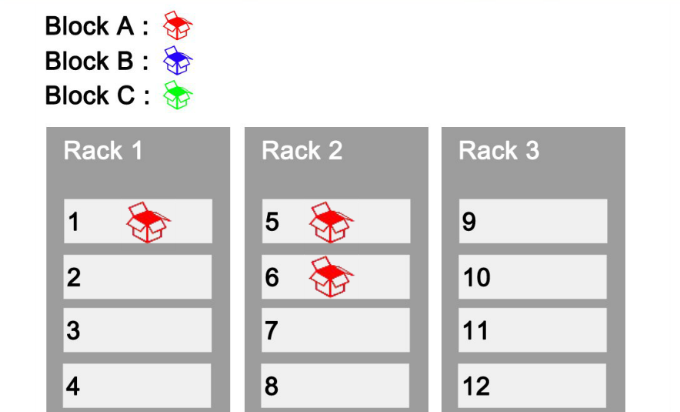

Slide 38
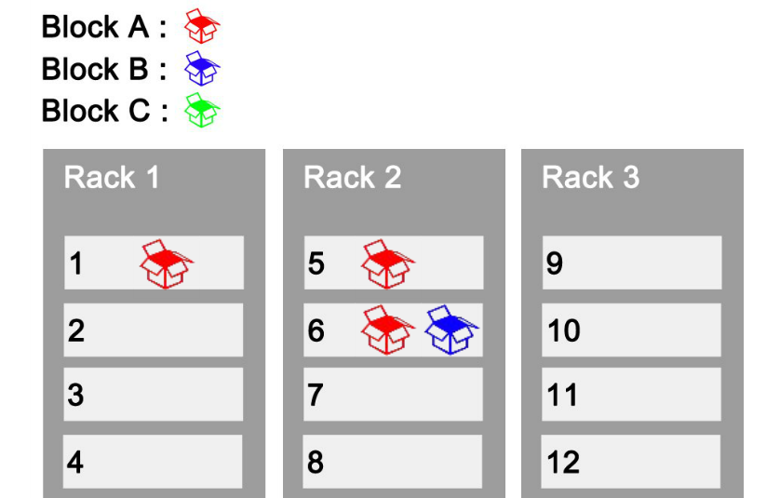

Slide 39
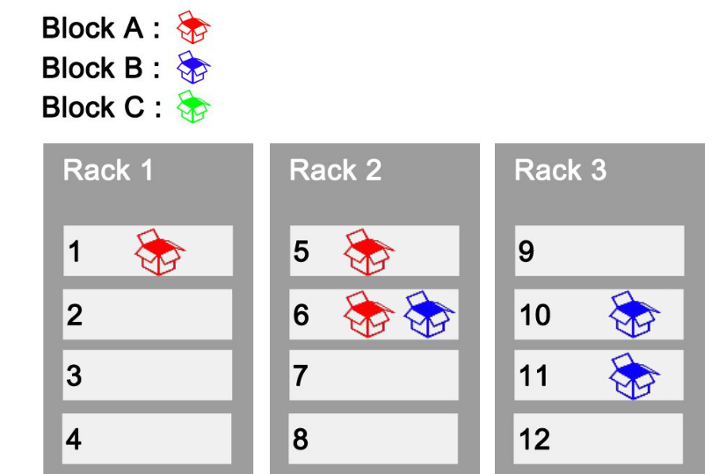

Slide 40
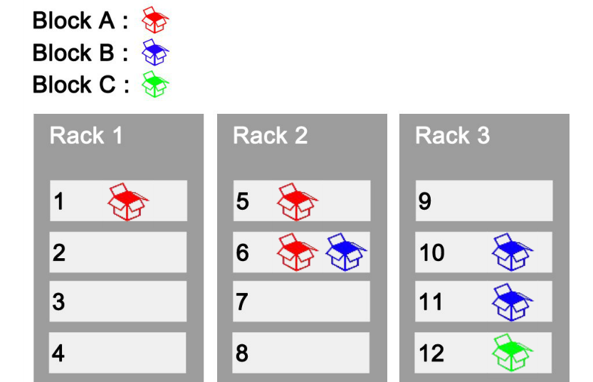

Slide 41
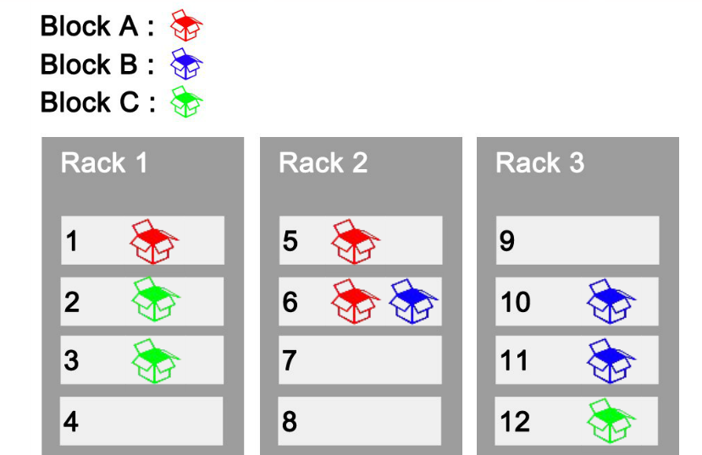

Slide 42
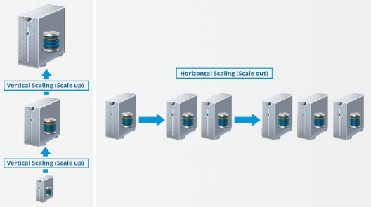
Advantages Of HDFS
Distributed Storage
Distributed & Parallel Computation
Horizontal Scalability

Slide 43
When not to use Hadoop ?
Low Latency data access : Quick access to small parts of data
Multiple data modification : Hadoop is a better fit only if we are primarily concerned about reading data and not modifying data.
Lots of small files : Hadoop is suitable for scenarios, where we have few but large files.

Slide 44

Thank You

